Slide 1

Usage based billing

Slide 2
Project team - 10
Name | Email | Initials
Karthik Cherukuru | kcherukuru1@student.gsu.edu | KC
Karthik Dulam | kdulam1@student.gsu.edu | KD
Venkat Sachin Reddy Katpally | vkatpally1@student.gsu.edu | VS
Ajith Singh Kshatri | akshatri1@student.gsu.edu | AS
Mahesh Kumar Ronde | mronde1@student.gsu.edu | MK

Slide 3

The case of Mr. Mahesh’s broadband connection---1
Mahesh learned from the service provider that they have just 3 service offerings for him—
His thoughts on service offerings….
300 GB – 60 $ per month ……….”waste of money”
100 GB – 30 $ per month ……....”I need more data than 100 GB”
Unlimited– 75 $ per month……..”no way”

Slide 4

The case of Mr. Mahesh’s broadband connection---2
Three months later….
Available data is used up in just 15 days
He is still reluctant to opt for 300 Giga Byte or un-limited plan.
So, he visits the service provider again to know if there are any suitable plans.

Slide 5
Problems from the case
The company is currently offering limited plans to customers
Users requirements doesn’t match with the plans provided
Due to unavailability of flexible broadband billing packages, users are reluctant to subscribe to their service.
Currently there is no tracking of the real-time Internet bandwidth used
Hard to analyze the broadband consumption pattern, in order to optimize the services for higher profits.

Slide 6
Business case
What?
Enhance the existing Billing system (Cable) to support real-time billing activities according to data usage.
How?
Change the existing system to receive, rate and bill the data usage coming from third party applications for each customer.
Why?
This solution will help customers by charging them based on their monthly data usage and facilitate operators in providing new plans based on statistical analysis.

Slide 7
Problems we intend to solve
To record every single usage activity of users
To create the usage bill of every user at the end of the billing cycle
To create the usage bill of users on demand at any point in the billing cycle(real-time)
Analytical approach through queries to determine the usage based plans

Slide 8
Scope
In-scope:
Cable and Broad band operators, as we can find multiple small and medium size operators in many countries don’t have a real-time billing system
Out of scope:
Telecom operators

Slide 9
Users
Database Administrators
Database Development Team
Front End Development Team
Company Associates
Vendor Development Team
Testing Team
Customers

Slide 10
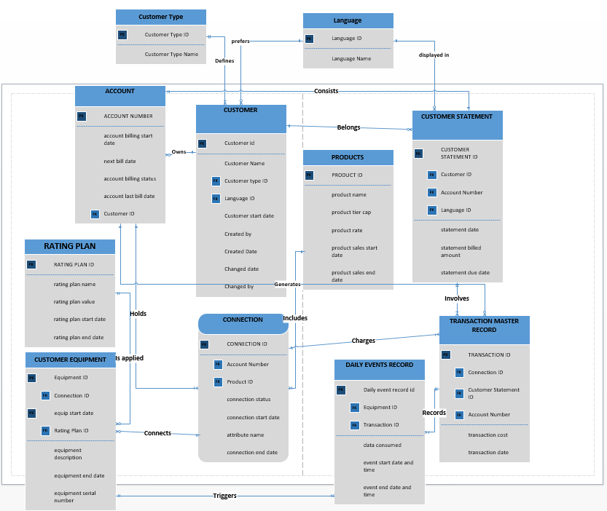
Updated ER diagram
ER Diagram

Slide 11
Updated functional dependency (3NF)
Team 10 3NF

Slide 12
Preliminary implementation
Following attachments contain the table creation, table description and data.
Table creation Table description Table contents

Slide 13
Query 1: To display the usage charges of customers
SELECT C.FIRSTNAME, C.LASTNAME, PROD.PRODUCTTIERCAP, DU.DATAUSAGE, RP.RATINGPLANVALUE, UC.USAGECHARGES FROM (SELECT EQUIPMENTID, SUM (DATACONSUMED) DATAUSAGE FROM DAILYEVENTSRECORD GROUP BY EQUIPMENTID) DU, CUSTOMEREQUIPMENT CE, (SELECT CONNECTIONID, SUM (TRANSACTIONCOST) USAGECHARGES FROM TRANSACTIONMASTERRECORD GROUP BY CONNECTIONID) UC, CONNECTION CON, PRODUCT PROD, RATINGPLAN RP, ACCOUNT A, CUSTOMER C WHERE DU.EQUIPMENTID=CE.EQUIPMENTID AND CE.CONNECTIONID=UC.CONNECTIONID AND CE.CONNECTIONID=CON.CONNECTIONID AND CON.PRODUCTID=PROD.PRODUCTID AND CE.RATINGPLANID=RP.RATINGPLANID AND CON.ACCOUNTNUMBER=A.ACCOUNTNUMBER AND A.CUSTOMERID=C.CUSTOMERID;

Slide 14
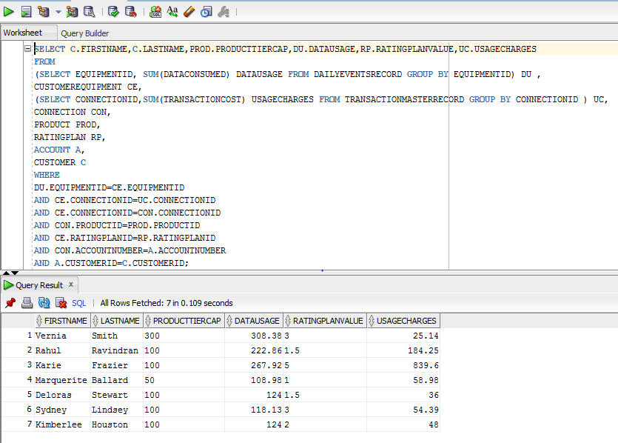
Output of Query 1

Slide 15
Query 2 : Identify & Reward top Customers
select C.accountnumber, E.Equipmentid, C.ConnectionID,E.ratingplanID, R.ratingplanname, SUM(D.Dataconsumed) As DataConsumed ,
RANK() over(partition by E.ratingplanID order by Sum(D.DataConsumed)desc)Rank
from DailyEventsRecord D, customerequipment E, connection C , Ratingplan R
where D.EquipmentID = E.EquipmentID
and E.ConnectionID = C.ConnectionID
and E.RatingplanID = R.RATINGPLANID
group by C.accountnumber, E.equipmentid, C.connectionID, E.RatingplanID, R.Ratingplanname

Slide 16
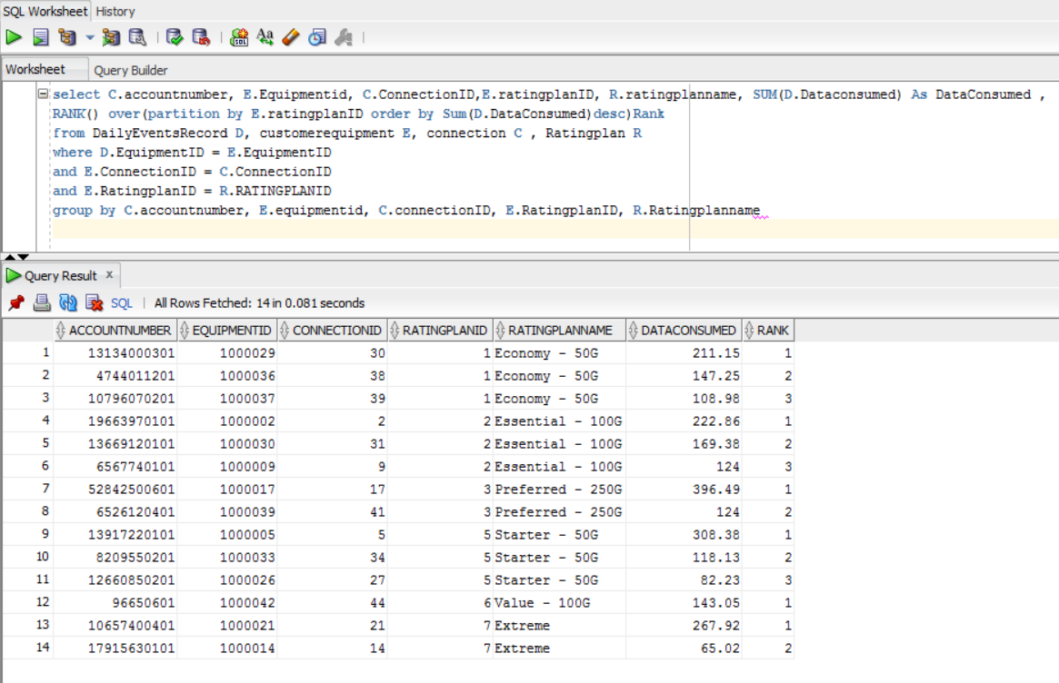
Output of Query 2

Slide 17
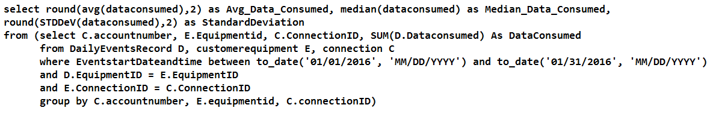
Query 3: Usage statistics

Slide 18
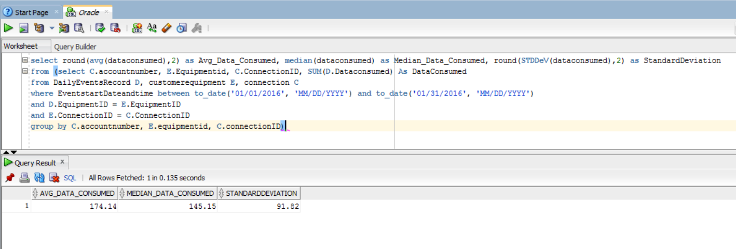
Output of Query 3

Slide 19
View to allow further analysis
Create view DataAnalysis
as (select C.accountnumber, E.Equipmentid, C.ConnectionID, SUM(D.Dataconsumed) As DataConsumed
from DailyEventsRecord D, customerequipment E, connection C
where D.EquipmentID = E.EquipmentID
and E.ConnectionID = C.ConnectionID
group by C.accountnumber, E.equipmentid, C.connectionID)

Slide 20
Challenges faced in the project
Data load challenges due to insufficient memory allocated to every user
Data integrity issues -- However, sql queries written by team helped us to identify and correct them.

Slide 21
Key learning or takeaways
We have gained a perspective on how to develop an idea.
We learned the aspects of:
Database modeling
Team management
Knowledge management
Issue tracking & resolution

Slide 22
Additional information
Feasibility of the project depends on introducing a hardware equipment that sends the data usage from third party sites on real time basis
A software entity to acknowledge the data received and send it to the database
Our database receives, records and rates the real-time data in an useful manner

Slide 23

Questions???

